Slide 1


Lecture 15:
Research Software Engineering & Open science
CoTaPP: Computational Thinking and
Programming with Python
All icons by: https://www.flaticon.com/

Slide 2

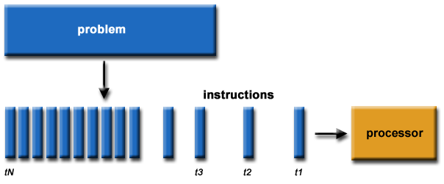
Previous lecture
Serial Computing
https://leonardoaraujosantos.gitbook.io/opencl/performance

Slide 3

Previous lecture
Parallel Computing
https://leonardoaraujosantos.gitbook.io/opencl/performance

Slide 4

Previous lecture

Slide 5


Previous lecture

Slide 6
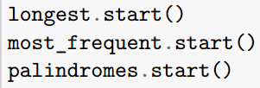
Previous lecture

Slide 7
Previous lecture

Slide 8
Previous lecture
MapReduce

Slide 9
Previous lecture
MapReduce
MapReduce is a programming model that enables massive scalability across hundreds or thousands of servers in a cluster
parallel + distributed programming

Slide 10

Previous lecture
MapReduce
MapReduce is a programming model that enables massive scalability across hundreds or thousands of servers in a cluster
parallel + distributed programming
https://www.ibm.com/topics/mapreduce#:~:text=MapReduce%20is%20a%20programming%20paradigm,tasks%20that%20Hadoop%20programs%20perform.

Slide 11
Previous lecture

Slide 12
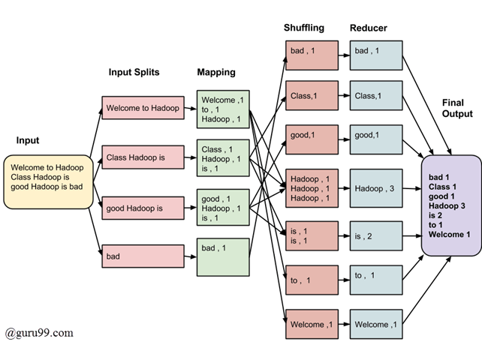
Previous lecture
https://www.guru99.com/introduction-to-mapreduce.html

Slide 13



Slide 14


Slide 15




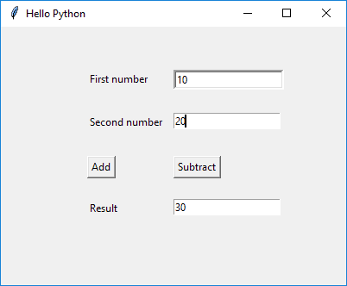

Slide 16





Slide 17


Slide 18
Today’s lecture
Citing Computer Code and Software Licenses
Research Software Engineering
Open Science
Tools / Concepts

Slide 19
Today’s lecture
Citing Computer Code and Software Licenses
Research Software Engineering
Open Science
Tools / Concepts
Activities
  Wooclaps
  Discussion in breakout rooms
  2 Videos
  General discussion

Slide 20
Citing Computer Code and Software Licenses

Slide 21
Writing Code
“Writing code is similar to academic writing in that when you use or adapt code developed by someone else as part of your project, you must cite your source.” (Academic Integrity at MIT)
https://integrity.mit.edu/handbook/writing-code#:~:text=When%20should%20I%20cite%20a,should%20still%20credit%20the%20source.

Slide 22
Writing Code
“Writing code is similar to academic writing in that when you use or adapt code developed by someone else as part of your project, you must cite your source.” (Academic Integrity at MIT)
We know that copying code/solutions from other students is wrong
https://integrity.mit.edu/handbook/writing-code#:~:text=When%20should%20I%20cite%20a,should%20still%20credit%20the%20source.

Slide 23
Writing Code
“Writing code is similar to academic writing in that when you use or adapt code developed by someone else as part of your project, you must cite your source.” (Academic Integrity at MIT)
We know that copying code/solutions from other students is wrong
But, the rules/cases for using/adapting code from other people (not peers) is not always that clear
https://integrity.mit.edu/handbook/writing-code#:~:text=When%20should%20I%20cite%20a,should%20still%20credit%20the%20source.

Slide 24
Activity #1
We are going to split in breakout rooms
Discuss with your classmates cases
  when is necessary to cite code
  when is NOT necessary to cite code
Write your cases in Wooclap
  next wooclap
Time: 10 min

Slide 25
Citing Code
General idea
  to some else, it should be clear what is your original contribution and what is based on other people’s contributions

Slide 26
Rule of thumb
Don’t cite:
  General patterns: if there is only one way to program a specific task and this is so commonly used then it may not need to be cited
    E.g., a "hello world" program, create a new window, read a column using Pandas
https://integrity.mit.edu/handbook/writing-code#:~:text=When%20should%20I%20cite%20a,should%20still%20credit%20the%20source.

Slide 27
Rule of thumb
Don’t cite:
  General patterns: if there is only one way to program a specific task and this is so commonly used then it may not need to be cited
    E.g., a "hello world" program, create a new window, read a column using Pandas
Cite:
  when copy code from an external source
  when copy the code and adapt it
https://integrity.mit.edu/handbook/writing-code#:~:text=When%20should%20I%20cite%20a,should%20still%20credit%20the%20source.

Slide 28
Rule of thumb
Don’t cite:
  General patterns: if there is only one way to program a specific task and this is so commonly used then it may not need to be cited
    E.g., a "hello world" program, create a new window, read a column using Pandas
Cite:
  when copy code from an external source
  when copy the code and adapt it
Follow the license. If there is no license, assume it has copyright
https://integrity.mit.edu/handbook/writing-code#:~:text=When%20should%20I%20cite%20a,should%20still%20credit%20the%20source.

Slide 29
Example (appropriate)
/**
* A utility class that gives applets the ability to detect proxy host settings.
* This was adapted from a post from Chris Forster on 20030227 to a Sun Java
* forum here:
* http://forum.java.sun.com/thread.jspa?threadID=364342&tstart=120
*/
<CODE>
Source: https://integrity.mit.edu/handbook/writing-code#:~:text=When%20should%20I%20cite%20a,should%20still%20credit%20the%20source.

Slide 30
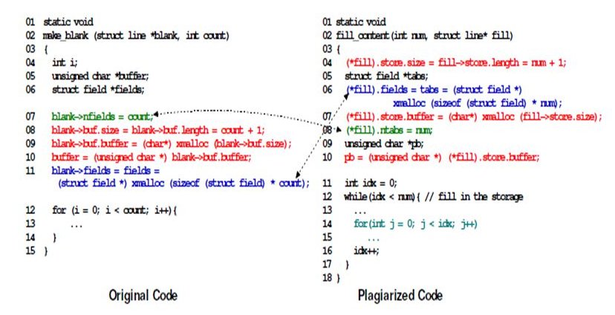
Example (inappropriate)
Source: https://codequiry.com/code-plagiarism#:~:text=Some%20Examples%20Of%20Code%20Plagiarism&text=This%20is%20when%20a%20student,common%20trend%20in%20the%20classroom.

Slide 31
Citing Code: Resources
https://lib.pstcc.edu/csplagiarism/citation
https://integrity.mit.edu/handbook/writing-code#:~:text=When%20should%20I%20cite%20a,should%20still%20credit%20the%20source.

Slide 32
Licenses
Copyright
  “Copyright (or author’s right) is a legal term used to describe the rights that creators have over their literary and artistic works. Works covered by copyright range from books, music, paintings, sculpture, and films, to computer programs, databases, advertisements, maps, and technical drawings” (WIPO)
If a work has copyright, you need to ask how you can use it
https://www.wipo.int/copyright/en/#:~:text=Copyright%20(or%20author's%20right)%20is,%2C%20maps%2C%20and%20technical%20drawings.

Slide 33
Open Source License
Open source licenses are licenses that allow software to be freely used, modified, and shared under defined terms and conditions

Slide 34
Open Source License
Popular Licenses
  Apache License 2.0
  BSD 3-Clause "New" or "Revised" license
  BSD 2-Clause "Simplified" or "FreeBSD" license
  GNU General Public License (GPL)
  GNU Library or "Lesser" General Public License (LGPL)
  MIT license
  Mozilla Public License 2.0
  Common Development and Distribution License
  Eclipse Public License version 2.0
https://opensource.org/licenses

Slide 35
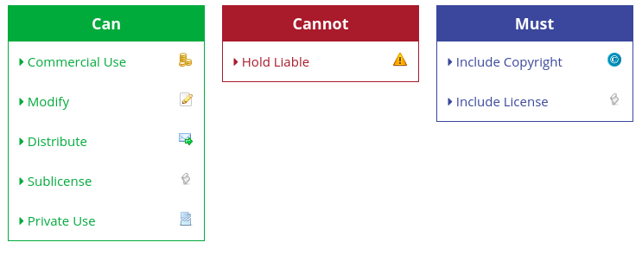
The MIT License
“Coffee Partner Lottery” from Project 3 has a MIT License
https://tldrlegal.com/

Slide 36
The MIT Licence
Begin license text.
Copyright <YEAR> <COPYRIGHT HOLDER>
Permission is hereby granted, free of charge, to any person obtaining a copy of this software and associated documentation files (the "Software"), to deal in the Software without restriction, including without limitation the rights to use, copy, modify, merge, publish, distribute, sublicense, and/or sell copies of the Software, and to permit persons to whom the Software is furnished to do so, subject to the following conditions:
The above copyright notice and this permission notice shall be included in all copies or substantial portions of the Software.
THE SOFTWARE IS PROVIDED "AS IS", WITHOUT WARRANTY OF ANY KIND, EXPRESS OR IMPLIED, INCLUDING BUT NOT LIMITED TO THE WARRANTIES OF MERCHANTABILITY, FITNESS FOR A PARTICULAR PURPOSE AND NONINFRINGEMENT. IN NO EVENT SHALL THE AUTHORS OR COPYRIGHT HOLDERS BE LIABLE FOR ANY CLAIM, DAMAGES OR OTHER LIABILITY, WHETHER IN AN ACTION OF CONTRACT, TORT OR OTHERWISE, ARISING FROM, OUT OF OR IN CONNECTION WITH THE SOFTWARE OR THE USE OR OTHER DEALINGS IN THE SOFTWARE.
End license text.

Slide 37
Software Licenses in Plain English
https://tldrlegal.com/

Slide 38
Creative Commons license
Creative Commons (CC) licenses are public licenses. You can use them to indicate what other people are allowed to do with your work
You can use them to any “work” that you produce, not only software

Slide 39
Research Software Engineering

Slide 40
Research Software Engineering
Research software engineering is the use of software engineering practices in research applications (Wikipedia)

Slide 41
Research Software Engineering
Research software engineering is the use of software engineering practices in research applications (Wikipedia).
→ Write software for your research

Slide 42
Research Software Engineering
Research software engineering is the use of software engineering practices in research applications (Wikipedia).
→ Write software for your research
→ You have the basis to write software for your research or at least engage in discussion with your team

Slide 43
Version control and code collaboration
Source: https://www.nobledesktop.com/blog/what-is-git-and-why-should-you-use-it

Slide 44
Version control and code collaboration
Git
  Is the most commonly used version control system
Source: https://www.nobledesktop.com/blog/what-is-git-and-why-should-you-use-it

Slide 45
Version control and code collaboration
Git
  Is the most commonly used version control system
  It tracks the changes you make to files, so you have a record of what has been done, and you can revert to specific versions should you ever need to
Source: https://www.nobledesktop.com/blog/what-is-git-and-why-should-you-use-it

Slide 46
Version control and code collaboration
Git
  Is the most commonly used version control system
  It tracks the changes you make to files, so you have a record of what has been done, and you can revert to specific versions should you ever need to
  It also makes collaboration easier, allowing changes by multiple people to all be merged into one source
Source: https://www.nobledesktop.com/blog/what-is-git-and-why-should-you-use-it

Slide 47

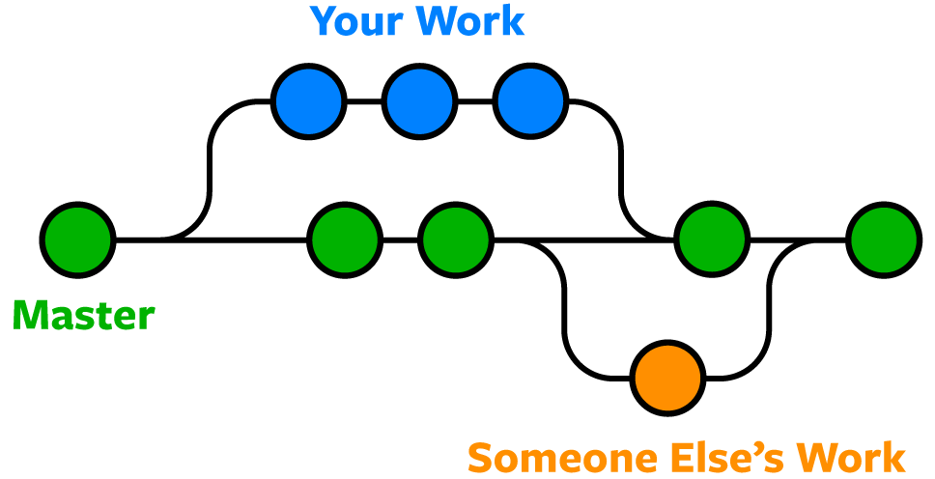


Version control and code collaboration
Source: https://www.nobledesktop.com/blog/what-is-git-and-why-should-you-use-it

Slide 48
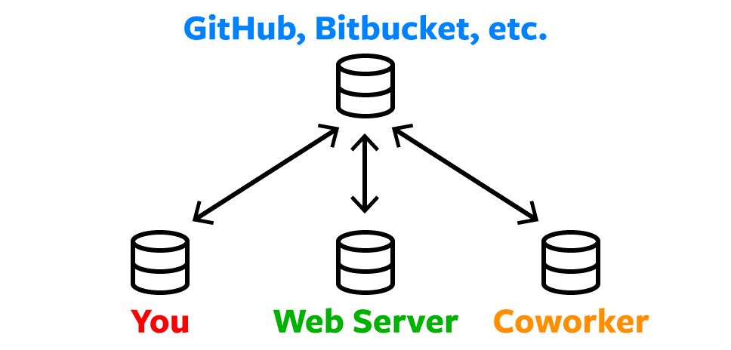
Remote Repositories
Source: https://www.nobledesktop.com/blog/what-is-git-and-why-should-you-use-it

Slide 49
Version control and code collaboration
Github
Source: https://www.coursereport.com/blog/what-is-github

Slide 50
Version control and code collaboration
Github
  “Coffee Partner Lottery” from Project 3 is shared on GitHub
Source: https://www.coursereport.com/blog/what-is-github

Slide 51
Version control and code collaboration
Github
  “Coffee Partner Lottery” from Project 3 is shared on GitHub
  GitHub, is a web application that hosts Git repositories.
Source: https://www.coursereport.com/blog/what-is-github

Slide 52
Version control and code collaboration
Github
  “Coffee Partner Lottery” from Project 3 is shared on GitHub
  GitHub, is a web application that hosts Git repositories.
  Private vs Public repositories
Source: https://www.coursereport.com/blog/what-is-github

Slide 53
Version control and code collaboration
Github
  “Coffee Partner Lottery” from Project 3 is shared on GitHub
  GitHub, is a web application that hosts Git repositories.
  Private vs Public repositories
  You can share your code, others can make modifications
Source: https://www.coursereport.com/blog/what-is-github

Slide 54
Version control and code collaboration
Github
  “Coffee Partner Lottery” from Project 3 is shared on GitHub
  GitHub, is a web application that hosts Git repositories.
  Private vs Public repositories
  You can share your code, others can make modifications.
  It is a data repository that can be used for Open Science
Source: https://www.coursereport.com/blog/what-is-github

Slide 55
Open Science

Slide 56
What is open science?
Open Science is the movement that aims at more open and collaborative research practices in which publications, data, software and other types of academic output are shared at the earliest possible stage and made available for reuse
https://www.nwo.nl/en/open-science

Slide 57
Discussion
Why is open science a good idea?
Can open science be applied in your field of study?
Can you think and give an example of how to apply open science in your field of study?
Does open science apply only to academic research? Or also to companies?

Slide 58
Publishing open access (OA)
https://authorservices.taylorandfrancis.com/publishing-open-access/oa-green-gold/

Slide 59
Publishing open access (OA)
Closed access:
  is the traditional form of scientific publishing. You can share article copies privately, but may not make them public
Gold open access
Publications are free for everybody Usually you need to pay the publisher.
Green open access
Also known as self-archiving
Post an earlier version of your manuscript (preprint) in repositories and online
https://authorservices.taylorandfrancis.com/publishing-open-access/oa-green-gold/

Slide 60
Publishing open access (OA)
Closed access:
  is the traditional form of scientific publishing. You can share article copies privately, but may not make them public
Gold open access
  Publications are free for everybody. Usually you need to pay the publisher
Green open access
Also known as self-archiving
Post an earlier version of your manuscript (preprint) in repositories and online
https://authorservices.taylorandfrancis.com/publishing-open-access/oa-green-gold/

Slide 61
Publishing open access (OA)
Closed access:
  is the traditional form of scientific publishing. You can share article copies privately, but may not make them public
Gold open access
  Publications are free for everybody. Usually you need to pay the publisher
Green open access
  Also known as self-archiving
  Post an earlier version of your manuscript (preprint) in repositories and online
https://authorservices.taylorandfrancis.com/publishing-open-access/oa-green-gold/

Slide 62
Preprint repositories
arXiv – Launched in 1991 this is the oldest and best-known paper preprint server. Fields of computer science, mathematics and physics.
ChemRxiv – a preprint sever for papers in chemistry.
BioRxiv – for preprints of research in biology and life sciences.
MedRxiv – preprints in health sciences
PsyArXiv – preprint server for papers in psychology
RePEc – preprints in economics
SocArXiv – preprints in social sciences
https://peerrecognized.com/open-science/

Slide 63
Open Data
Data repositories for storing and sharing research data, code, and methodology
General repositories
Zenodo: A general-purpose open-access repository developed under the European OpenAIRE program and operated by CERN.
Specific repositories
UniProtKB: Protein sequences
Data Repository Guidance: https://www.nature.com/sdata/policies/repositories
https://peerrecognized.com/open-science/

Slide 64
Open Data
Data repositories for storing and sharing research data, code, and methodology
General repositories
  Zenodo: A general-purpose open-access repository developed under the European OpenAIRE program and operated by CERN.
Specific repositories
UniProtKB: Protein sequences
Data Repository Guidance: https://www.nature.com/sdata/policies/repositories
https://peerrecognized.com/open-science/

Slide 65
Open Data
Data repositories for storing and sharing research data, code, and methodology
General repositories
  Zenodo: A general-purpose open-access repository developed under the European OpenAIRE program and operated by CERN.
Specific repositories
  UniProtKB: Protein sequences
Data Repository Guidance: https://www.nature.com/sdata/policies/repositories
https://peerrecognized.com/open-science/

Slide 66
Open Data
Data repositories for storing and sharing research data, code, and methodology
General repositories
  Zenodo: A general-purpose open-access repository developed under the European OpenAIRE program and operated by CERN.
Specific repositories
  UniProtKB: Protein sequences
Data Repository Guidance: https://www.nature.com/sdata/policies/repositories
https://peerrecognized.com/open-science/

Slide 67

https://www.youtube.com/watch?v=7xNGVzlG11o

Slide 68
To Do
No more exercises on quaterfall
  Submit last one about lecture 14
MasteryGrids → Consent form available next week
  Time until the 14/April to use the platform towards the bonus credit
Work on the last project
Study/practice for the final exam
  Next week instructions on the final exam: you will program!

Slide 69
Next Week
Guest lecture: Code Quality 101
  Hieke Keuning, assistant professor @ UU
Campus + online
  Nice to have good participation on-campus
Afterwards, labs to work on project 4

